Slide 1
TalkingData mobile user demographics
Kaggle Competition Analysis and Insights

Slide 2

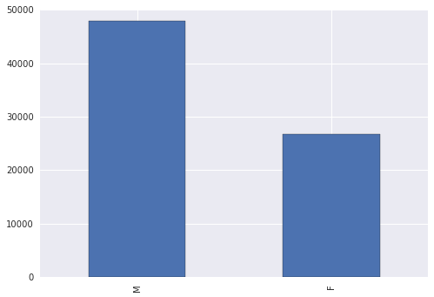
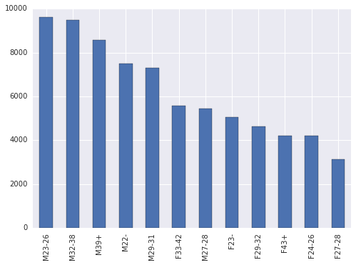
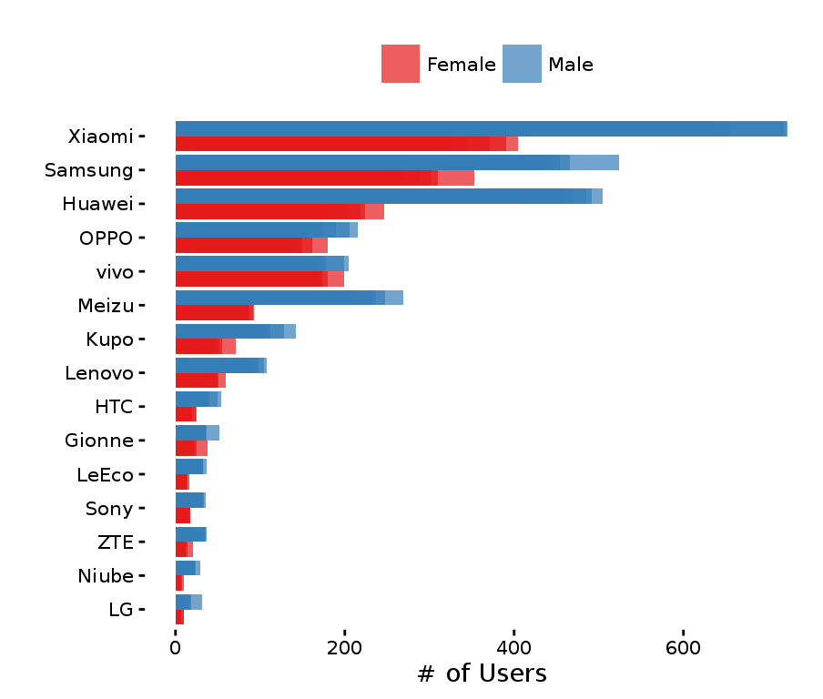
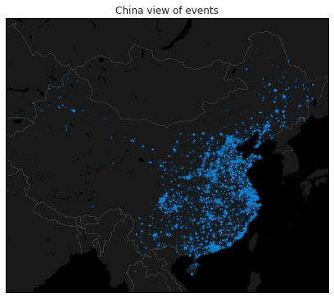
Overview
Mobile app analytics and advertising
Embedded 120,000 apps
In 70% of China’s 500m mobile devices
Predict age and gender based on
App usage
931 categories
Device location
Latitude & longitude
Brand & model
$25k prize money
1,689 teams entered

Slide 3
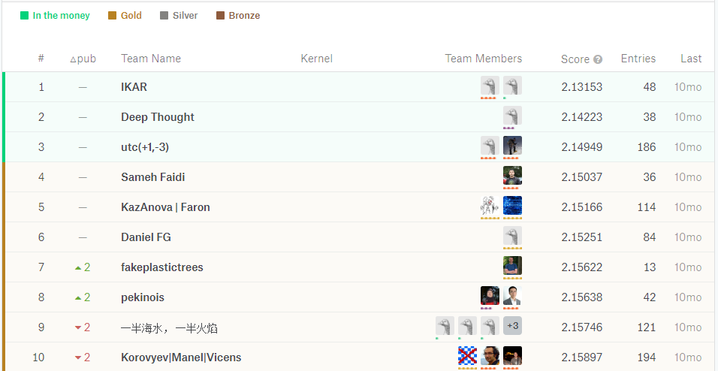
Competition
Provided Data
Training Data: 74,645 devices
Test Data: 112,071 devices (no age/gender)
Evaluation
Submit probability for each gender/age class
Multi-class logarithmic loss
Public leader board during competition
Private leader board for final prizes
Approaches
Neural Networks
Logistic Regression
XGBoost

Slide 4
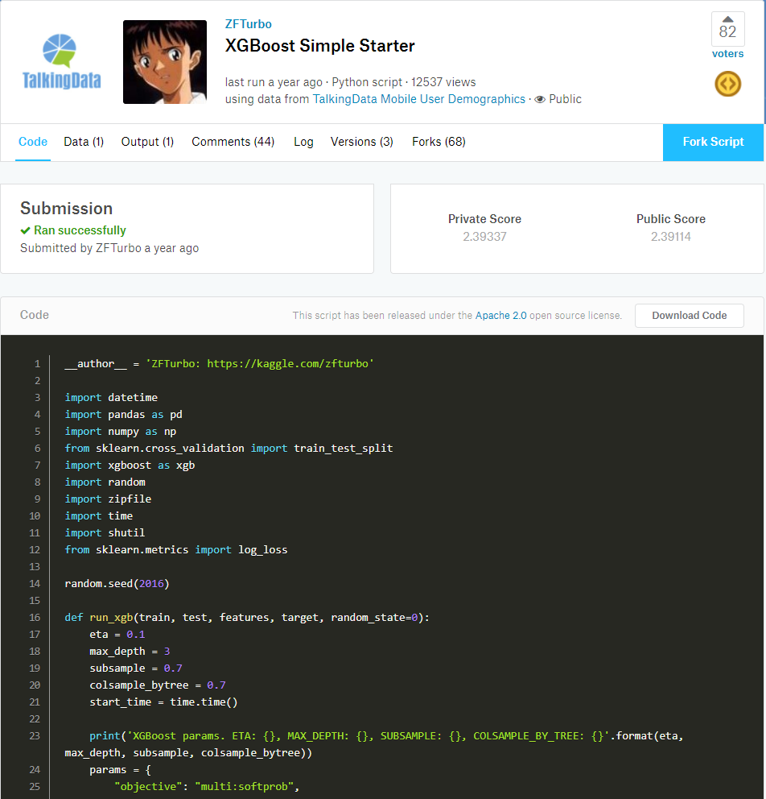
Data Leakage
“the creation of unexpected additional information in the training data, allowing a model or machine learning algorithm to make unrealistically good predictions”¹
Data leakage in training set
Individuals had multiple user IDs
Same user in both training and test data sets
Duplicate IDs were grouped together
Flagged by one contestant
Cross-validation showed significantly difference between folds
Competition was not changed
Leakage was allowed to be exploited
Proposing Data Leakage prize
20% to first person to find
¹https://www.kaggle.com/wiki/Leakage

